Slide 1
G PULLAIAH COLLEGE OF ENGINEERING AND TECHNOLOGY
(An Autonomous Institute affiliated to JNTUA, Ananthapuram)
DEPARTMENT OF COMPUTER SCIENCE AND ENGINEERING
Leveraging Transfer Learning to Analyze Software Developers Opinions for Enhanced Project Insights
Project Coordinator
K MANJUSHA
MTech.,
HOD
Mrs K. LAKSHMI MTech.,(Ph.D)
Project Guide Dr.S.Prem Kumar MTech., Ph.D.
BOLLE RAJKISHORE (21AT1A0516)
BELLAGAM SYED MOHAMMED ASHWAK (21AT1A014)
KASI HARISH (22AT5A0505)
CHITTAM DURGA CHARAN REDDY (21AT1A0524)
Team Members

Slide 2
Contents
Abstract
Introduction
Literature Survey
Existing System
Existing System disadvantages
Proposed System
Modules
Methodology
Algorithms
Advantages of proposed system
Hardware & Software components
Input and output screen shot
Future scope
Conclusion

Slide 3
Abstract
This project aims to improve sentiment analysis in software development by using a hybrid model that combines machine learning and deep learning techniques. Models like Random Forest detect data patterns, while MLP and CNN-1D extract important text features. BERT brings contextual understanding, and GPT enhances language interpretation. Together, these models form a powerful system that delivers more accurate sentiment classification and deeper insights into developer opinions, helping teams make better project decisions. The system can handle both structured and unstructured textual feedback, adapts well to domain-specific vocabulary used by developers, and is suitable for real-world software teams and product feedback loops.

Slide 4
INTRODUCTION
Social media is a key platform for developers to share opinions and feedback.
Sentiment analysis helps understand these opinions for better software development decisions.
Traditional methods often struggle with the complexity of language and context.
This project uses a mix of ML and DL models (Random Forest, MLP, CNN-1D, BERT, GPT).
Aim: Build a more accurate and context-aware sentiment analysis system.
Combines strengths of both traditional and modern AI techniques.
Enables deeper insights into developer mood, feedback, and collaboration.

Slide 5
LITERATURE SURVEY
Vaswani, A., et al. (2017). "Attention Is All You Need."
This seminal paper introduces the Transformer architecture, which forms the basis of models like BERT.
https://arxiv.org/abs/1706.03762
Devlin, J., et al. (2019). "BERT: Pre-training of Deep Bidirectional Transformers for Language Understanding."
The paper detailing the creation and use of BERT for natural language processing tasks.
https://arxiv.org/abs/1706.03762
Howard, J., & Ruder, S. (2018). "Universal Language Model Fine-tuning for Text Classification."
Discusses transfer learning in NLP and its effectiveness for text classification tasks.
https://arxiv.org/abs/1706.03762
Zhang, L., et al. (2018). "Sentiment Analysis: A Literature Review."
A comprehensive review of sentiment analysis methods, challenges, and applications.
https://arxiv.org/abs/1706.03762

Slide 6
EXISTING SYSTEM
Rule-Based Methods
Uses predefined word lists or sentiment rules (positive/negative) to classify text manually.
Lexicon-Based Approach
Depends on sentiment lexicons like Senti WordNet or VADER to score sentiment based on known word values.
Machine Learning Models
Algorithms like Naive Bayes and SVM are trained from scratch on labeled datasets.
Requires large amounts of data for accurate performance.
Text Preprocessing
Involves cleaning techniques such as tokenization, stop-word removal, and stemming to prepare input text.

Slide 7
EXISTING SYSTEM DISADVANTAGES
1. Struggles with Informal Language: Difficulty handling slang, abbreviations, and emojis commonly used in social media.
2. Lack of Context Understanding: Unable to grasp the nuances or context of sentiment expressions, leading to potential misclassifications.
3. Manual Effort: Requires extensive manual work to create and maintain sentiment lexicons and rules.
4. Scalability Issues: Difficulty in scaling to handle large volumes of diverse text data efficiently.
5. Slow Processing with Large Datasets: Resource-heavy and slower processing, especially with large datasets or high-dimensional features.

Slide 8
PROPOSED SYSTEM
The proposed system is a hybrid sentiment analysis model designed to extract meaningful insights from software developers' feedback. It combines machine learning models like Random Forest for pattern recognition with deep learning models such as MLP and CNN-1D to automatically learn text features. Additionally, advanced transformer-based models like BERT are used for contextual understanding of text, while GPT improves language representation and interpretation. Together, these models enhance sentiment classification accuracy, handle both structured and unstructured data, and provide deeper insights into developer opinions to support better decision-making in software projects.

Slide 9
MODULES
Data Selection
Data Pre-processing
Text Pre-processing
Vectorization
Data splitting
Classification
Estimate Performance
Prediction

Slide 10








Proposed System architecture
Sentiment CSV Dataset
Preliminary Process
( Handling missing values, Label encoding)
Data Slicing
(Test and Train data)
Text Preprocessing
(NLP)
Feature Extraction
(Count Vectorization)
Performance Metrics
(Accuracy and Error Rate)
Classification
(Feeding data to models)
Prediction
(Positive, Negative or neutral)

Slide 11
METHODOLOGY
Dataset Collection: Use sentiment datasets from a repository, with labels (positive, negative, neutral).
Preprocessing: Handle missing values, apply label encoding, and clean text using NLP techniques (stop words removal, stemming, punctuation removal, tokenization, and padding).
Vectorization: Convert text into numerical format using Count Vectorization.
Data Splitting: Split the data into train and test sets.
Model Implementation: Use BERT, MLP, Random Forest, and CNN-1D for sentiment classification.
Evaluation: Assess performance with metrics like accuracy, precision, recall, F1-score, and error rate.
Prediction: Predict sentiment (positive, negative, neutral) from user input.
Validation: Compare accuracy improvements over existing methods.

Slide 12
ALGORITHMS
Random Forest (RF)
Ensemble of decision trees making predictions by majority vote.
Handles large datasets well, capturing complex patterns in noisy text.
MLP (Multi-Layer Perceptron)
Neural network with multiple layers of neurons.
Learns complex relationships and is effective for classification tasks.
CNN-1D (Convolutional Neural Networks for Text)
Applies convolutions to sequential data like text.
Extracts local patterns and features from text, useful for sentiment analysis.
BERT (Bidirectional Encoder Representations from Transformers)
Transformer model reading text both left-to-right and right-to-left.
Captures contextual meaning, improving understanding of nuanced sentiments.
GPT (Generative Pretrained Transformers)
Generates accurate and context-rich text representations for sentiment analysis.

Slide 13
ADVANTAGES OF PROPOSED SYSTEM
Improved Accuracy
The hybrid approach leverages strengths from both machine learning and deep learning models, leading to more accurate sentiment predictions.
Contextual Understanding
Models like BERT and GPT capture the context and meaning of words in a sentence, improving analysis of complex or nuanced text
Reduced Data Requirements
Since BERT and GPT are pre-trained, they require less labeled data for fine-tuning compared to traditional models.
Adaptability to Domain-Specific Language
The system can be fine-tuned for software development-related sentiment, making it more effective for analyzing developer opinions and technical content.

Slide 14
TECHNOLOGIES
HARDWARE REQUIREMENTS
System : Pentium IV 2.4 GHz
Hard Disk : 512 GB
Mouse : Logitech.
Keyboard : 110 keys enhanced
Ram : 12/16 GB
SOFTWARE REQUIREMENTS
O/S : Windows 10.
Language : Python
Front End : HTML,CSS
Framework : FLASK and STREAM Lit
Software used :Anaconda Navigator – Spyder

Slide 15
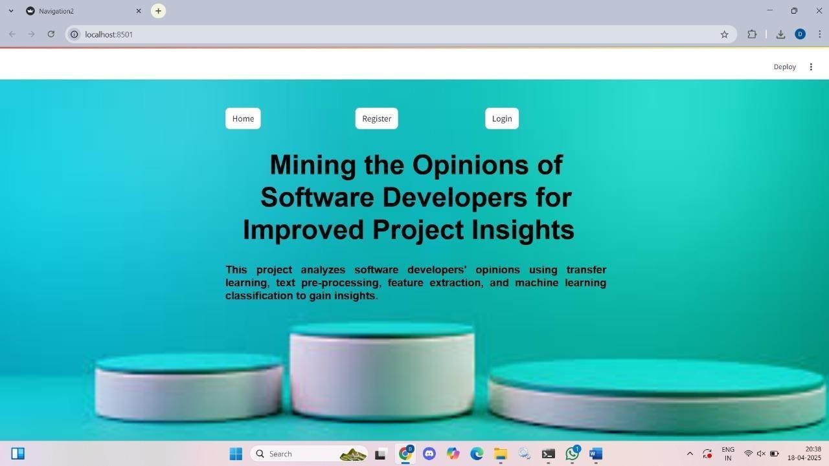
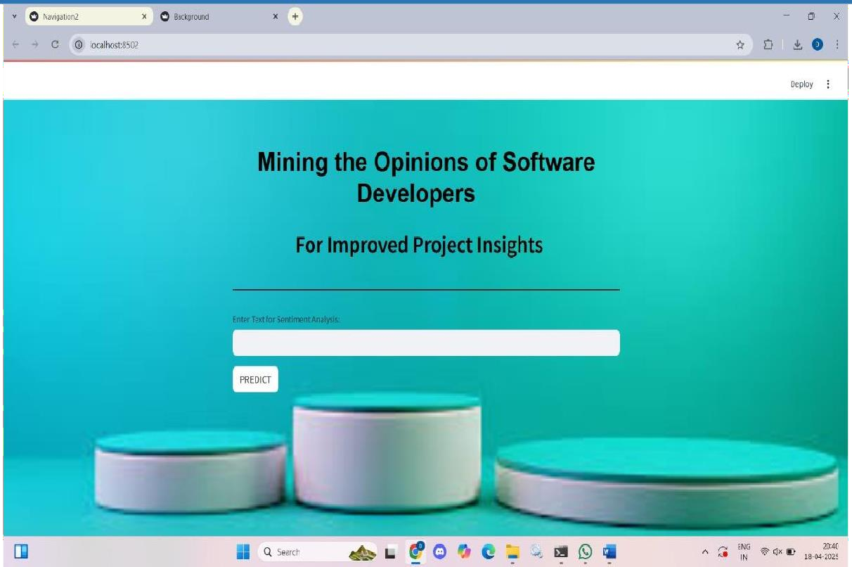
Inputs
A simple UI form for developers to submit opinions or feedback.
Example: "The last sprint was hectic, and deployment failed due to merge conflicts."
Input is then passed to the backend for analysis.

Slide 16
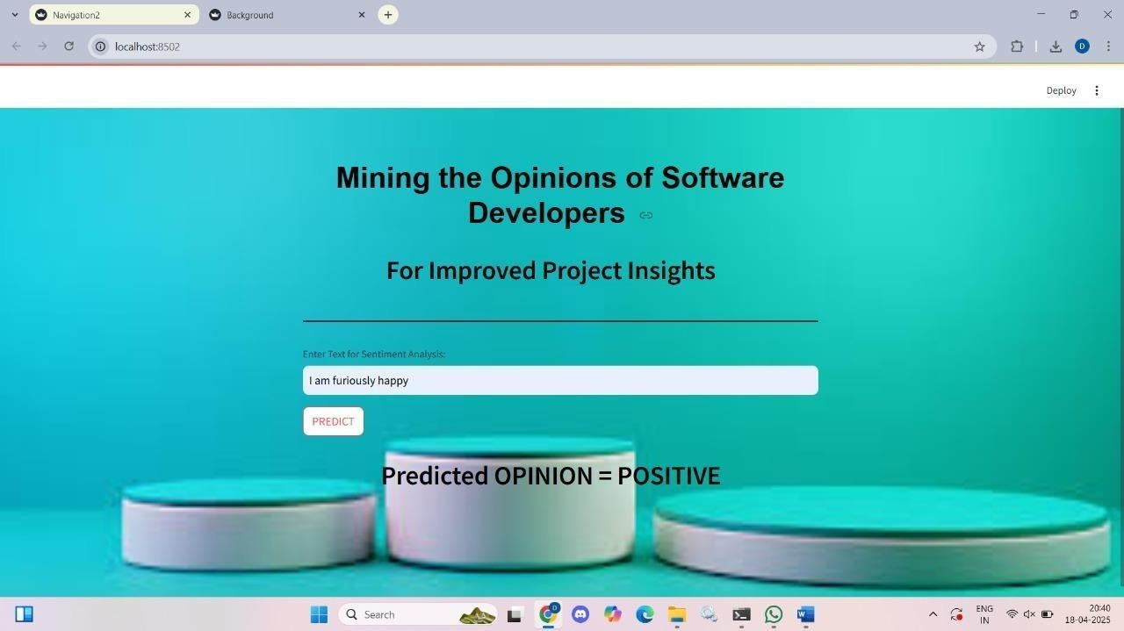
Output: Sentiment Classification
The system returns the sentiment of the submitted opinion:
- Positive
- Negative
- Neutral
Example: Input: "I enjoyed working on the new API; everything was smooth."
Output: Positive

Slide 17
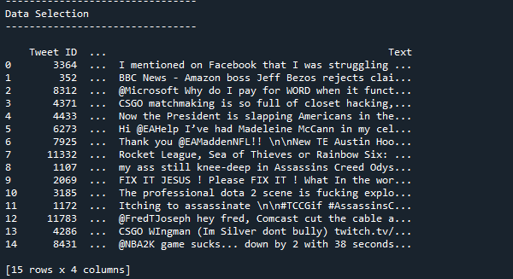
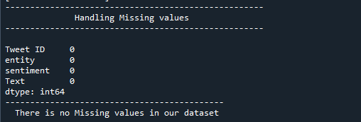
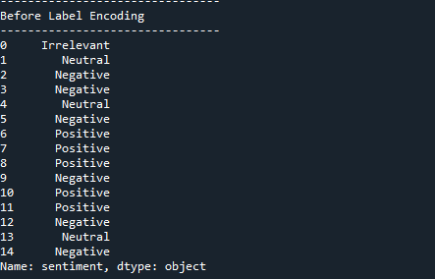
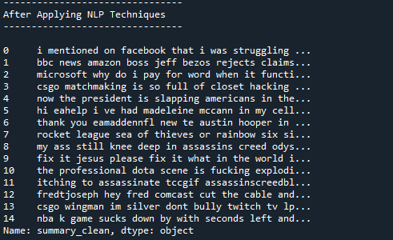
Back End Processing

Slide 18
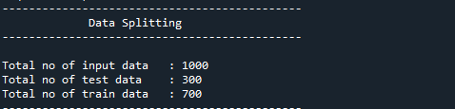
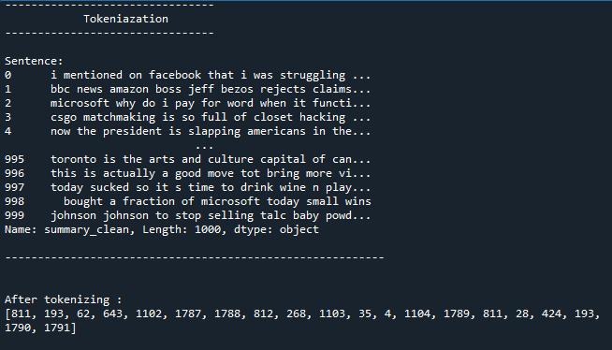
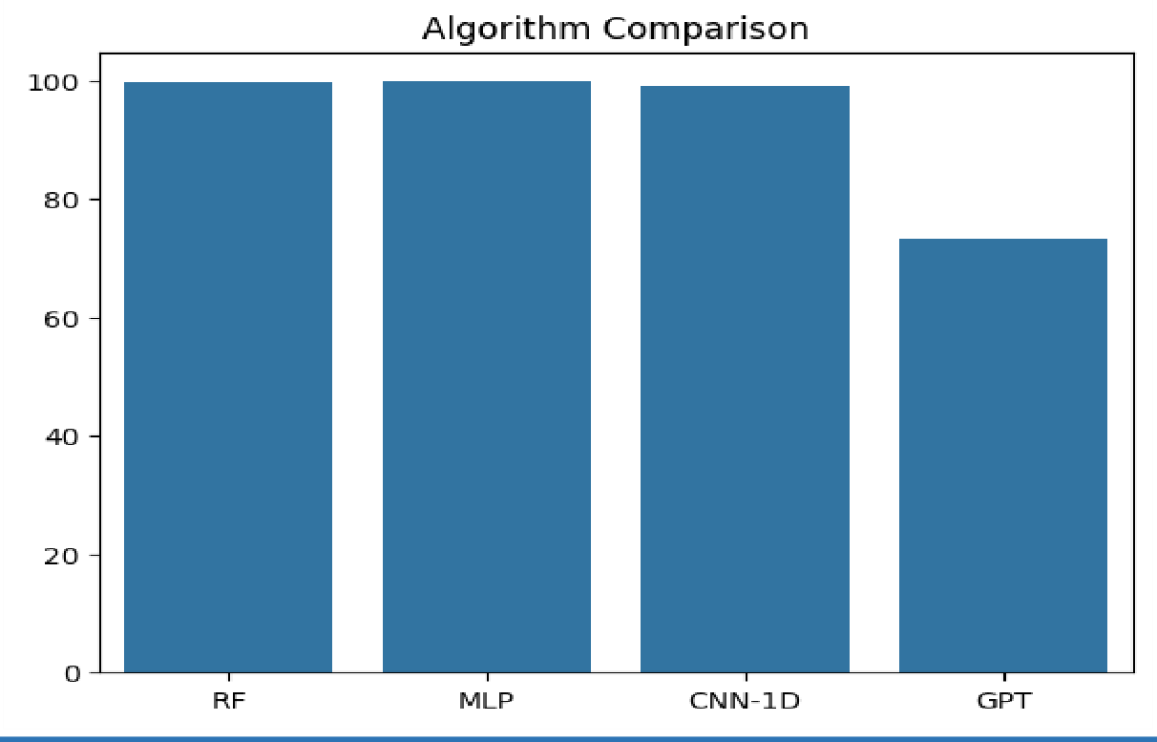
BACK END PROCESSING

Slide 19
FUTURE SCOPE
The future scope of the proposed sentiment analysis system includes expanding its capabilities to analyze real-time data from social media and customer feedback, as well as supporting multiple languages to reach a global audience. There is potential for deeper emotional understanding, capturing more nuanced sentiments such as sarcasm or joy. The system could be personalized to offer more tailored insights based on user behavior and preferences. Advancements in models like BERT and GPT could further enhance contextual understanding, while the integration of hybrid models could improve accuracy and efficiency. Additionally, the system could find applications in various industries such as healthcare, finance, and education, and offer predictive analytics to help businesses anticipate trends and customer needs.

Slide 20
CONCLUSION
In conclusion, the proposed sentiment analysis system leverages a combination of advanced machine learning and deep learning models, including Random Forest, MLP, CNN-1D, BERT, and GPT, to enhance the accuracy and depth of sentiment classification. By capturing both contextual nuances and complex patterns in textual data, particularly from social media, the system provides valuable insights that can inform decision-making in software development and project management. Its ability to handle large datasets, evaluate performance metrics, and predict sentiment effectively positions it as a powerful tool for understanding public opinion and improving customer engagement strategies, with promising potential for future enhancements and applications across various industries.

Slide 21
QUERIES?

Slide 22
THANK YOU

